Slide 1
Decoding Strategies
CS XXX: Introduction to Large Language Models

Slide 2
Contents
Generating Text
Greedy Decoding
Beam Search Decoding
Top k Sampling
Top p (Nucleus) Sampling
Generation Parameters

Slide 3
Generating Text
Generate next token based on the current context
Input Sentence
Word Embeddings
Model
Output
sea 22%
blue 17%
river 16%
ocean 14%
when 0.01%
under 0.01%
bicycle 0.001%
Decoder Transformer Blocks
The fish lived in the
The
fish
lived
in
the
Choose next token: blue
sea 32%
blue 5%
river 16%
ocean 15%
when 0.001%
under 0.001%
bicycle 0.01%
Decoder Transformer Blocks
The fish lived in the blue
The
fish
lived
in
the
blue
Choose next token: sea

Slide 4
Generating Text
More concretely, Once language model trained we generate the text in the following way
Sample a word in the output from the softmax distribution that results from using the beginning of sentence marker, <s>, as the first input.
Use the word embedding for that first word as the input to the network at the next time step, and then sample the next word in the same fashion.
Continue generating until the end of sentence marker, </s>, is sampled or a fixed length limit is reached.
The goal of sequence generation is to produce a sequence of tokens that maximizes the overall probability of the complete sequence given the context.

Slide 5
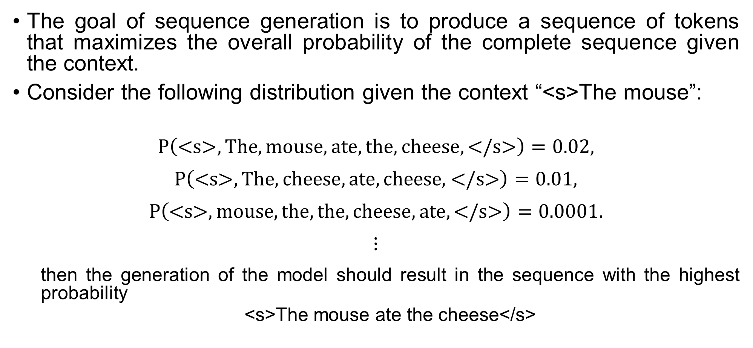
Generating Text
The goal of sequence generation is to produce a sequence of tokens that maximizes the overall probability of the complete sequence given the context.
Consider the following distribution given the context “<s>The mouse”:
$$P\left(\text{<}\text{s}\text{>},The,mouse,ate,the,cheese,\text{</}\text{s}\text{>}\right)=0.02,$$
$$P\left(\text{<}\text{s}\text{>},The,cheese,ate, \text{cheese}\text{, </}\text{s}\text{>}\right)=0.01,$$
$$P\left(\text{<}\text{s}\text{>},mouse,the,the,cheese,ate,\text{</}\text{s}\text{>}\right)=0.0001.$$
$$⋮$$
then the generation of the model should result in the sequence with the highest probability
<s>The mouse ate the cheese</s>

Slide 6
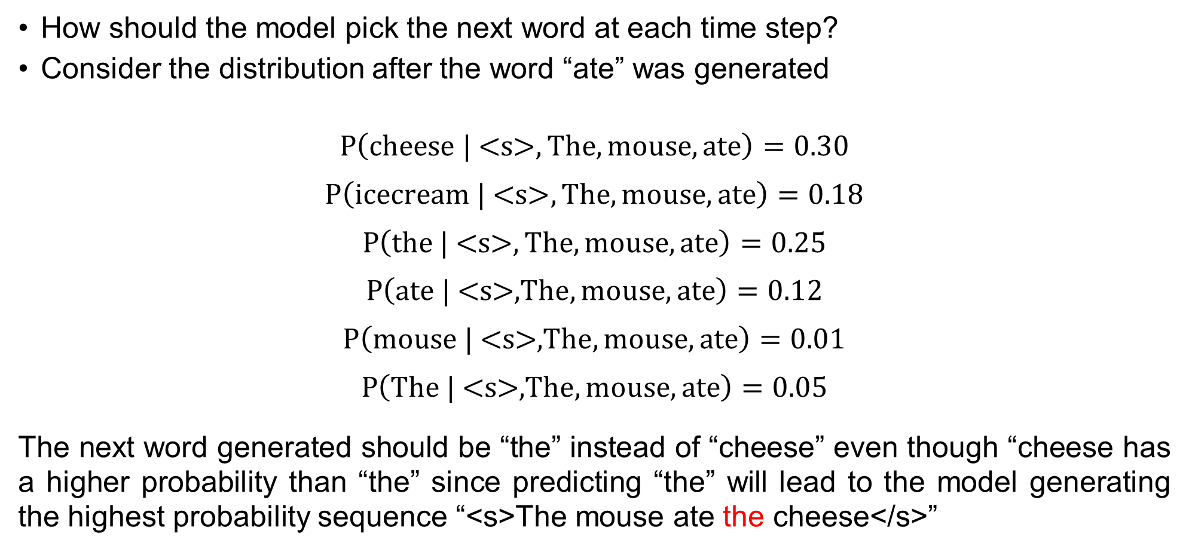
Generating Text
How should the model pick the next word at each time step?
Consider the distribution after the word “ate” was generated
$$P\left(\text{cheese}\text{ | <}\text{s}\text{>}, The,mouse,ate\right)=0.30$$
$$P\left(\text{icecream}\text{ |} \text{<}\text{s}\text{>},The,mouse,ate\right)=0.18$$
$$P\left(\text{the}\text{ |} \text{<}\text{s}\text{>},The,mouse,ate\right)=0.25$$
$$P\left(\text{ate}\text{ |} \text{<}\text{s}\text{>,}The,mouse,ate\right)=0.12$$
$$P\left(\text{mouse}\text{ |} \text{<}\text{s}\text{>,}The,mouse,ate\right)=0.01$$
$$P\left(\text{The}\text{ | <}\text{s}\text{>,}The,mouse,ate\right)=0.05$$
The next word generated should be “the” instead of “cheese” even though “cheese has a higher probability than “the” since predicting “the” will lead to the model generating the highest probability sequence “<s>The mouse ate the cheese</s>”

Slide 7
Decoding Strategies
Decoding strategies in Large Language Models (LLMs) refer to different methods used to generate text from a model's probability distribution over the vocabulary.
These strategies determine how the next word (or token) is selected and can significantly impact the quality, coherence, and diversity of generated text.

Slide 8
Greedy Decoding
Greedy Decoding: Choose the token with the greatest probability at each time step.
Input Sentence
Word Embeddings
Model
Output
sea 15%
blue 22%
river 16%
ocean 14%
when 0.01%
under 0.01%
bicycle 0.001%
Decoder Transformer Blocks
<s>The fish lived in the
The
fish
lived
in
the
Choose next token: blue
sea 32%
blue 5%
river 16%
ocean 15%
when 0.001%
under 0.001%
bicycle 0.01%
Decoder Transformer Blocks
<s>The fish lived in the blue
The
fish
lived
in
the
blue
Choose next token: sea

Slide 9
Greedy Decoding
Greedy Decoding: Choose the token with the greatest probability at each time step.
We terminate generation once the end of sequence token (</s>) is predicted or when the number of tokens predicted is equal to some max length.

Slide 10
Greedy Decoding
Greedy Decoding: Choose the token with the greatest probability at each time step.
We terminate generation once the end of sequence token (</s>) is predicted or when the number of tokens predicted is equal to some max length.
Problem: Choosing the token with the highest probability may be locally optimal but not globally since optimal sequence generation requires considering the entire sequence probability, not just picking the most likely word at each step. Since greedy decoding does not explore multiple options, it often produces repetitive text. Greedy decoding always produces the same output for a given input (lack of diversity).
Notes:
Greedy decoding has several major issues that can lead to suboptimal or unnatural sentences:
1. Myopic Decision-Making
Greedy decoding selects the highest probability token at each step without considering future choices.
This can cause the model to miss globally more probable sequences.
Example:
Given: The fish lived in the
Greedy output: The fish lived in the ocean is blue. (incorrect)
Beam search might produce: The fish lived in the river near the trees. (better)
2. Lower Overall Probability
While greedy decoding picks the most probable token at each step, the overall sequence probability may be lower than other possible sequences.
This is because locally optimal choices do not always form a globally optimal sentence.
3. Early Trapping in Bad Sequences
If an early choice is incorrect, the model has no way to backtrack.
This can lead to grammatically incorrect or nonsensical outputs.
Example:
If the model picks “ocean” early on, it might struggle to complete the sentence naturally.
4. Repetitive Outputs
Since greedy decoding does not explore multiple options, it often produces repetitive text.
Example: The cat sat on the mat. The cat sat on the mat. The cat sat...
This happens because the highest probability token at each step can keep repeating.
5. Lack of Diversity
Greedy decoding always produces the same output for a given input.
Other methods like beam search or sampling introduce diversity, leading to more varied and natural responses.
Alternatives to Greedy Decoding
Beam Search: Keeps multiple candidate sequences and selects the best one.
Top-k Sampling: Randomly samples from the top-k highest probability tokens.
Nucleus Sampling (Top-p): Samples from the smallest set of tokens whose cumulative probability exceeds p.
Greedy decoding is fast and efficient, but it sacrifices quality and coherence for speed.

Slide 11
Beam Search
Keep track of n most probable partial translations at each decoder step instead of just one!
the beam size n is usually 5-10

Slide 12
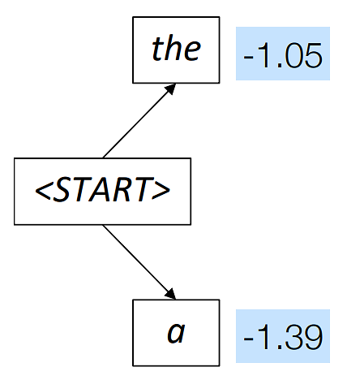
Beam Search
Beam Size = 2

Slide 13

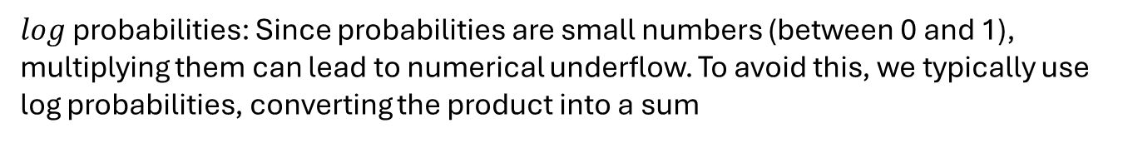
Beam Search
Beam Size = 2
Consider only the 2 (beam size) most likely words at the first time step
$$\text{P}\text{(<}\text{START}\text{>, }\text{the}\text{) = }\text{log}\text{(}\text{P}\left(\text{the} | \text{<}\text{START}\text{>}\right)×\text{P}\left(\text{<}\text{START}\text{>}\right)\text{)}=\text{log}\text{(}\text{P}\text{(}\text{the}\text{∣}\text{<}\text{START}\text{>}\text{)}\text{) }\text{+} \text{log}\text{(}\text{P}\text{(<}\text{START}\text{>)}\text{)}$$
$log$ probabilities: Since probabilities are small numbers (between 0 and 1), multiplying them can lead to numerical underflow. To avoid this, we typically use log probabilities, converting the product into a sum
$$\text{P}\text{(<}\text{START}\text{>,} \text{a}\text{) =} \text{log}\text{(}\text{P}\left(\text{a} | \text{<}\text{START}\text{>}\right)×\text{P}\left(\text{<}\text{START}\text{>}\right))=\text{log}\text{(}\text{P}\text{(}\text{a}\text{∣}\text{<}\text{START}\text{>}\text{)}\text{) }\text{+} \text{log}\text{(}\text{P}\text{(<}\text{START}\text{>)}\text{)}$$
Note that $\text{P}\left(\text{<}\text{START}\text{>}\right)=1$, $\log\left(1\right)=0$

Slide 14
Beam Search
Beam Size = 2
Consider only the 2 (beam size) most likely words at the first time step
Expand the current branches (2) by considering the next 2 most likely tokens for each branch

Slide 15
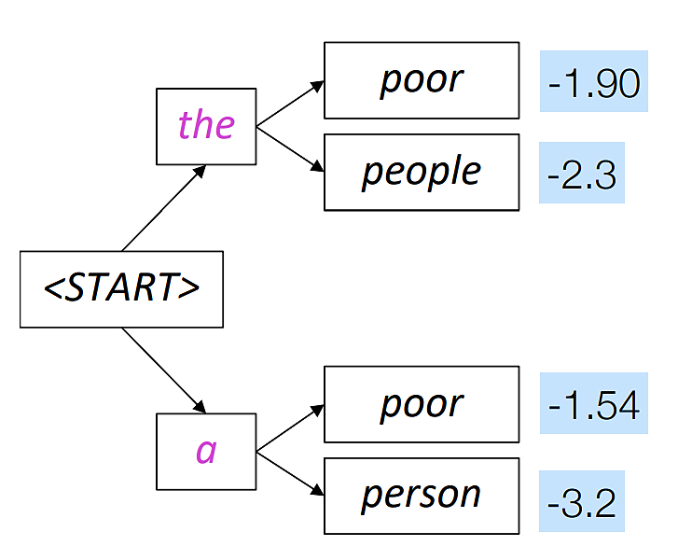
Beam Search
Beam Size = 2
Cumulative probability of “<START>the poor”
Cumulative probability of “<START>the people”
Cumulative probability of “<START>a poor”
Cumulative probability of “<START>a person”

Slide 16
Beam Search
Beam Size = 2
$$log⁡(P\left(\text{poor} | \text{<}\text{START}\text{>},\text{the}\right)×P\left(\text{<}\text{START}\text{>,}\text{the}\right))$$
$$log⁡(P\left(\text{people} | \text{<}\text{START}\text{>},\text{the}\right)×P\left(\text{<}\text{START}\text{>, }\text{the}\right))$$
$$log⁡(P\left(\text{poor} | \text{<}\text{START}\text{>},\text{a}\right)×P\left(\text{<}\text{START}\text{>,}\text{the}\right))$$
$$log⁡(P\left(\text{poor} | \text{<}\text{START}\text{>},\text{s}\right)×P\left(\text{<}\text{START}\text{,}\text{the}\text{>}\right))$$

Slide 17
Beam Search
Beam Size = 2
Expand the 2 highest probability branches. The other branches are pruned

Slide 18
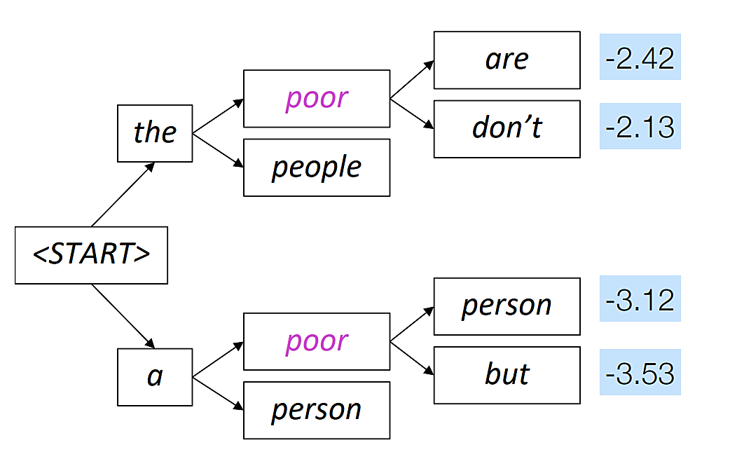
Beam Search
Beam Size = 2

Slide 19
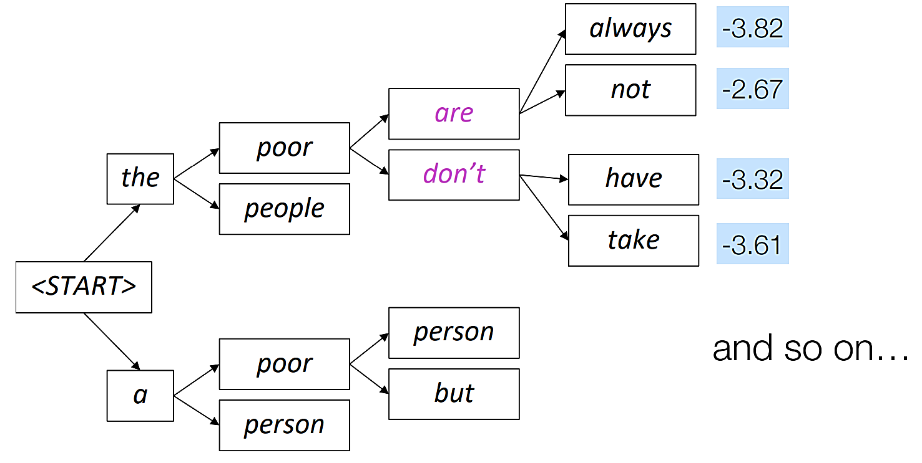
Beam Search

Slide 20
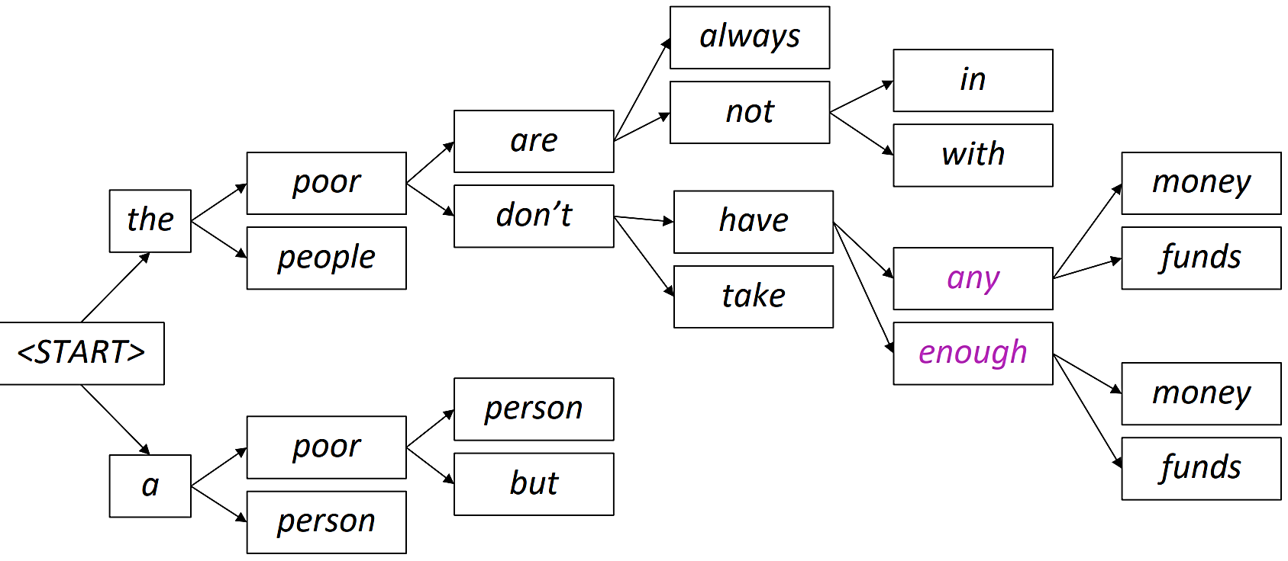
Beam Search

Slide 21
Beam Search
Generation stops when all N (beam size) branches have either predicted the end-of-sequence (EOS e.g. </s>) token or reached the maximum allowed length.
Once generation terminates, the sequence with the highest cumulative probability is selected as the final output.

Slide 22
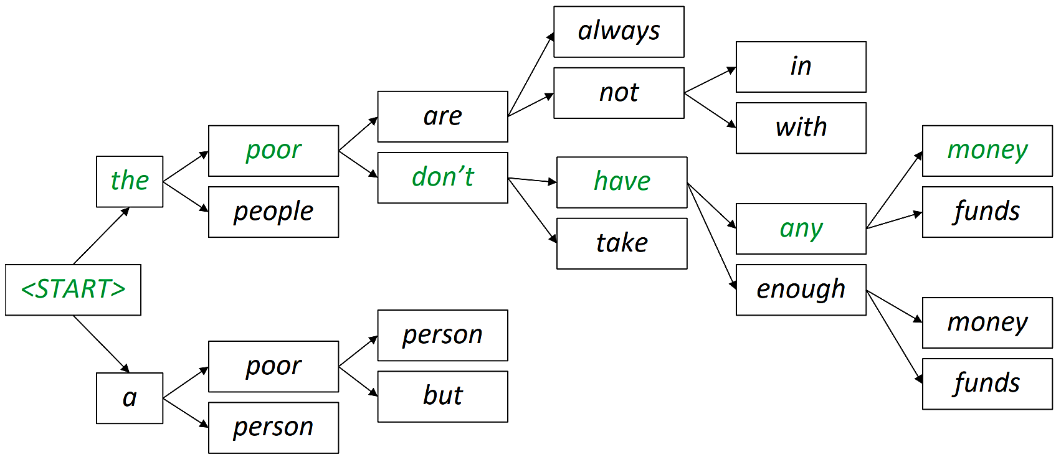
Beam Search
Once generation terminates, the sequence with the highest cumulative probability is selected as the final output.

Slide 23
Beam Search
Effect of beam size N
Small N means consider less hypotheses. The resulting generated sequence is likely to be ungrammatical, unnatural, nonsensical, or incorrect.
Large N means consider more hypotheses. The resulting generated sequence is likely to be more grammatical and natural, however larger N is more computationally expensive. A larger N may also make the generation more generic and less relevant.

Slide 24

Top k Sampling
On each step t, randomly sample from $P_{t}$,restricted to just the top-k most probable words
Consider the probability distribution over the vocabulary in the following example
sea 32%
blue 5%
river 16%
ocean 15%
when 0.001%
under 0.001%
bicycle 0.01%
Decoder Transformer Blocks
<s>The fish lived in the blue
The
fish
lived
in
the
blue
Choose next token: sea

Slide 25
Top K Sampling
Consider the probability distribution over the vocabulary in the following example
If k = 4 the distribution is truncated to
sea 32%
blue 5%
river 16%
ocean 15%
when 0.001%
under 0.001%
bicycle 0.01%
Decoder Transformer Blocks
<s>The fish lived in the blue
The
fish
lived
in
the
blue
Choose next token: sea
sea 32%
river 16%
ocean 15%
blue 5%
Note that this truncation is done at each time step

Slide 26
Top K Sampling
If k = 4 we truncate the distribution to
Now we randomly sample from the distribution. That is, 47.06% of the time we choose “sea” to be the next token, 23.53% of the time we choose “river” to be the next token, 22.06% of the time we choose “ocean” to be the next token, and 7.35% of the time we choose “blue” to be the next token.
sea 32%
river 16%
ocean 15%
blue 5%
sea 47.06%
river 23.53%
ocean 22.06%
blue 7.35%
Normalize

Slide 27

Top p (Nucleus) Sampling
Truncate the distribution $P_{t}$, at every time step $t$, to the smallest set of words for which the cumulative probability just exceeds p
Consider the probability distribution over the vocabulary in the following example
sea 32%
blue 5%
river 16%
ocean 15%
when 0.001%
under 0.001%
bicycle 0.01%
Decoder Transformer Blocks
<s>The fish lived in the blue
The
fish
lived
in
the
blue
Choose next token: sea

Slide 28
Top p (Nucleus) Sampling
Consider the probability distribution over the vocabulary in the following example
If p = 0.6 the distribution is truncated to
sea 32%
blue 5%
river 16%
ocean 15%
when 0.001%
under 0.001%
bicycle 0.01%
Decoder Transformer Blocks
<s>The fish lived in the blue
The
fish
lived
in
the
blue
Choose next token: sea
sea 32% = 0.32
river 16% = 0.16
ocean 15% = 0.15
Note that this truncation is done at each time step

Slide 29
Top p (Nucleus) Sampling
Now we randomly sample from the distribution. That is, 50.79% of the time we choose “sea” to be the next token, 25.39% of the time we choose “river” to be the next token, and 23.81% of the time we choose “ocean” to be the next token.
sea 32% = 0.32
river 16% = 0.16
ocean 15% = 0.15
sea 50.79% = 0.5079
river 25.39% = 0.2539
ocean 23.81% = 0.2381

Slide 30
Generation parameters
0 1 3 4 5 6 7 8 9 10 11 12 13 14 15 16 17 18 19 20 21 | from transformers import pipeline # Initialize the pipeline with a real model gen = pipeline("text-generation", model="gpt2") # Using GPT-2 as an example model # Define generation parameters generation_params = { "max_length": 50, # Maximum length of the output "top_p": 0.9, # Nucleus sampling (top_p) "top_k": 50, # Top-k sampling "num_beams": 5, # Beam search (set to 1 for greedy decoding) "early_stopping": True, # Stop when at least `num_beams` sentences are finished "temperature": 0.7 # Controls randomness (lower = more deterministic) } # Use the pipeline text = "The fish lived in" output = gen(text, **generation_params) # Print the output print(output)

Slide 31
References
Iyyer, M. (Instructor). (2022). Advanced Natural Language Processing (CS 685) UMass Amherst

